Slide 1


INTERNAL MEDICINE CLINICAL PROBLEME SOLVING CONFERENCE
Presented by: Narjes Beiranvand, MD
INTERNAL MEDICINE RESIDENT
20 JULY 2026

Slide 2
Step1

Slide 3
HX & PH/E
ID : The patient is a 59-year-old married woman, mother of three children, residing in Tehran
CC:ABDOMINAL PAIN

Slide 4
PI: The patient is a 59-year-old married woman, mother of three, residing in Tehran, with a past medical history of hypertension and rheumatoid arthritis (RA), who presented with a 6-day history of generalized abdominal pain.
The pain is predominantly localized to the periumbilical and hypogastric regions. It is constant, radiates to the lower back, and is not affected by changes in body position. The pain is temporarily relieved by acetaminophen/codeine but recurs after the effect of the medication wears off. There is no association between the pain and food intake.
Review of systems is negative for fever, nausea, vomiting, diarrhea, constipation, dysuria, urinary frequency, melena, hematochezia (rectorrhagia), skin rash or other cutaneous lesions, chest pain, and dyspnea.
She does report swelling and morning stiffness involving the small joints of the fingers, consistent with her underlying rheumatoid arthritis.

Slide 5
PMH : HTN ' She was diagnosed with rheumatoid arthritis (RA) 4 years ago and had been receiving treatment with azathioprine, prednisolone, topical tacrolimus, and prednisolone eye drops. However, 2 years ago, she discontinued all of her medications on her own because of progressive weight gain and abdominal distension.

Slide 6
PSH : cataract extraction
AH : neg
FH : neg
HH : neg

Slide 7
REVIEW OF SYSTEM
General: Positive for fatigue
Negative for fever or night sweats.
Dermatologic: Positive for dry skin . Negative for rash, skin thickening.
Eyes : No visual disturbances, eye pain, redness, or dryness
Ear :No hearing loss, tinnitus, ear pain, or discharge.
Nose :No nasal congestion, rhinorrhea, epistaxis, or sinus pain .
Negative for chest pain, palpitations, orthopnea, or syncope.
Respiratory: negative for exertional dyspnea
Negative for cough, wheezing, hemoptysis, or pleuritic chest pain
Limb : Swelling and morning stiffness of the finger joints

Slide 8
REVIEW OF SYSTEM
Gastrointestinal:Generalized abdominal pain radiating to the periumbilical and hypogastric regions.
Negative for nausea, vomiting, abdominal pain, diarrhea, constipation, melena, or hematochezia.
Genitourinary: Negative for dysuria, hematuria, urinary frequency, urgency, or change in urine output.
Musculoskeletal: Negative for myalgia, arthralgia, joint swelling, or morning stiffness.
Endocrine: Negative for heat or cold intolerance, polyuria, or polydipsia.
Hematologic: Negative for easy bruising or bleeding.
Neurologic: negative for dizziness.
Negative for headache, syncope, focal neurologic deficits, or seizures.
Psychiatric: Negative for depression, anxiety, or sleep disturbance.

Slide 9
PHYSICAL EXAM
▪ Alert, Orient to TPP, Not ill, Not Toxic
▪ V/S:
▪ BP: 130/80 PR: 85 RR: 18 T: 37.1 O2sat in room air: 98%

Slide 10
PHYSICAL EXAM
Skin:
Normal. No rash, or ulcers. Cyanosis of lips.
Head and Neck:
The Conjunctiva is not pale, the Sclera is not icteric .The size of the pupils is normal and reactive .no Cyanosis of lips and mouth . no bruit in the carotid artery area
Cardiovascular:
heart sounds were diminished with regular rate and rhythm.
No murmurs, rubs, or gallops. No heave or thrill
Respiratory:
Chest expansion normal . lungs clear to auscultation bilaterally. Decreased breath sounds at the lung bases are bilateral .No wheezing, crackles, or rhonchi.

Slide 11
PHYSICAL EXAM
Abdomen:
Soft, non-tender, non-distended.
No organomegaly or ascite
Extremities:
Swelling and morning stiffness of the finger joints
Neurologic:
Grossly intact. No focal neurologic deficits. Normal proximal and distal force.

Slide 12
STEP2

Slide 13
WBC | 4.7 | NA | 135 | ALP | 300 | TIBC | 287
HB | 10.5 | K | 4.2 | BILI T | 0.8 | FE | 62
PLT | 183 | CA | 9.2 | BILI D | 0.2 | CHOL | 136
ESR | 58 | ALB | 4.3 | AMYLAZ | 55 | TG | 77
CRP | 198 | MG | 1.8 | LIPASE | 53 | PT | 13.9
BUN | 18 | P | 3.1 | FERITIN | 245 | PTT | 41
CR | 1.1 | AST | 50 | RA | 7.3 | INR | 1.04
URIC ACID | 4.6 | ALT | 35 | FBS | 205

Slide 14
U/A |  | VBG
SG | 1.025 | PH | 7.43
PR | +1 | PCO2 | 41.6
BACTER | FEW | HCO3 | 24.4
WBC | 10-15
RBC | 0-1

Slide 15
Sono : Abdominopelvic Ultrasonography
* The liver is normal in size with normal parenchymal echogenicity.
* The gallbladder has a normal wall thickness and is free of gallstones or sludge.
* The intrahepatic bile ducts, portal vein, and common bile duct (CBD) are unremarkable within the limits of the examination.
* The spleen measures 101 mm and demonstrates normal echogenicity.
* The right kidney measures 93 mm in length with a parenchymal thickness of 11 mm. No hydronephrosis is identified. No renal calculi are seen.
* The left kidney measures 101 mm in length with a parenchymal thickness of 12 mm. No hydronephrosis is identified.
* Both kidneys are normal in size and echogenicity. A 5-mm calculus is noted in the upper calyx of the left kidney. In addition, microlithiasis is present in all three calyceal groups of the left kidney.
* The renal parenchymal echogenicity is normal bilaterally.
* The pancreas and para-aortic region could not be adequately evaluated because of excessive bowel gas.
Pelvic Ultrasonography
* The urinary bladder is empty, precluding adequate evaluation of the pelvis.
* No free fluid is identified in the pelvis.

Slide 16
CONSULT
Surjery : no emergency surgical intervention is required
Ophtalmology : there is no evidence of vasculitis . She is advised to follow up at outpation clinic after discharge

Slide 17
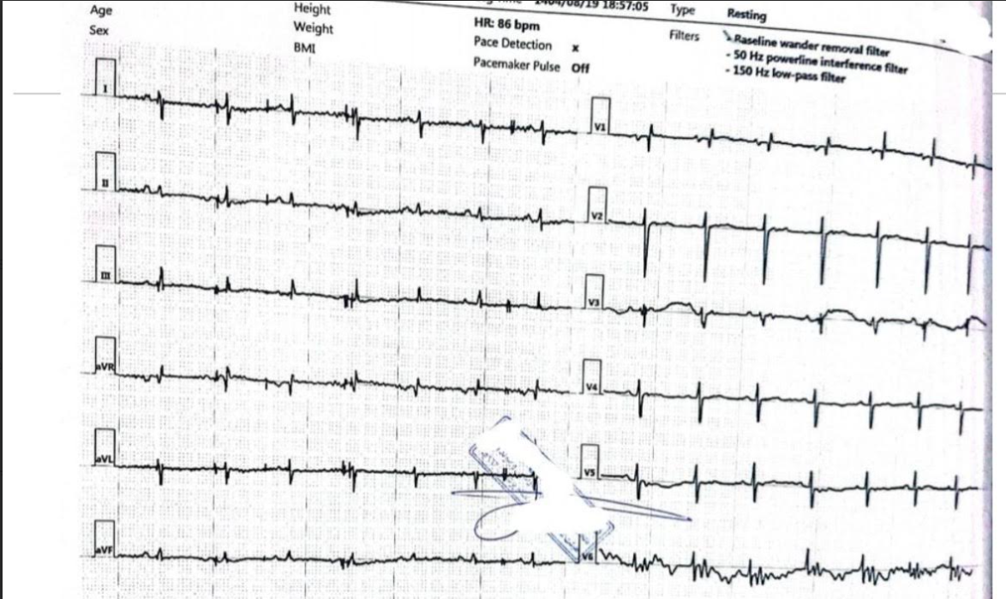

Slide 18
STEP3

Slide 19
Echo : Normal LV size with Good systolic function (EF:55%).
-No significant RWMA at rest.
-No LVH.
-No LV diastolic dysfunction.
-Normal RV size with normal systolic function.
-Normal MVLs, Mild MR, no MS.
-Tricuspid AV, no AR, no AS.
-Normal TVLs, mild TR (unmeasurable TRG) ,no TS
-Normal PVLs, no PS , trivial PI.
-Low probable for PH based on indirect echo findings.
-No mass on cardiac valves and chambers on 3D TTE.
-No Pericardial Effusion.

Slide 20
CTA

Slide 21
Evidence of enhancing soft tissue with surrounding inflammatory changes is seen along the aorta, extending from the infrarenal segment to beyond the aortic bifurcation. These findings result in irregularity of the aortic wall and are suggestive of aortitis.

Slide 22
STEP4

Slide 23
U24 PR | 285 | C3 | 144 | ANTI CCP | 3.3
U24 CR | 765 | C4 | 33 | ANTI DS DNA | 10
UPEP | NL | IGG1 | 523 | C ANCA | <3
SPEP | NL | IGG2 | 679 | ANA | 0.574
BONE DENS | -1.3 | IGG3 | 730 | CH50 | 103.8
WRITE | NEG | IGG4 | 10.6 | PANCA | 3.8
COOMBS WRITE | NEG | IGG T | 2090
2ME | NEG | ACE | 70

Slide 24
STEP5
DIAGNOSIS:
RA + VASCULITIS OF AORTA
TREATMENT :
DEXA 8mg BD & DISCHARGE WITH PREDNISOLONE 10mg Daily

Slide 25
STEP6
FALLOW:
SUPRIMONE 500 BD
REDUSE DOSE PREDNISOLONE
ALLENDRONATE 70 EVERY WEAK
VITAMIN D 1000 DAILY

Slide 26
STEP7
PLAN:
FOLLOW UP 4 MONTH LATER
The patient should return to the outpatient clinic in four months with the laboratory test results for reassessment and possible up-titration of the mycophenolate dose.

